Slide 1



Communication and In-group Working Skills (cont.)

Slide 2

CHAPTER OUTLINE
4. Social Comparison

Slide 3

LEARNING OBJECTIVES
Understand the reasons people make social comparisons.
Identify consequences of social comparison
Understand the Self-Evaluation Maintenance Model.
Explain situational factors that can affect social comparison.

Slide 4
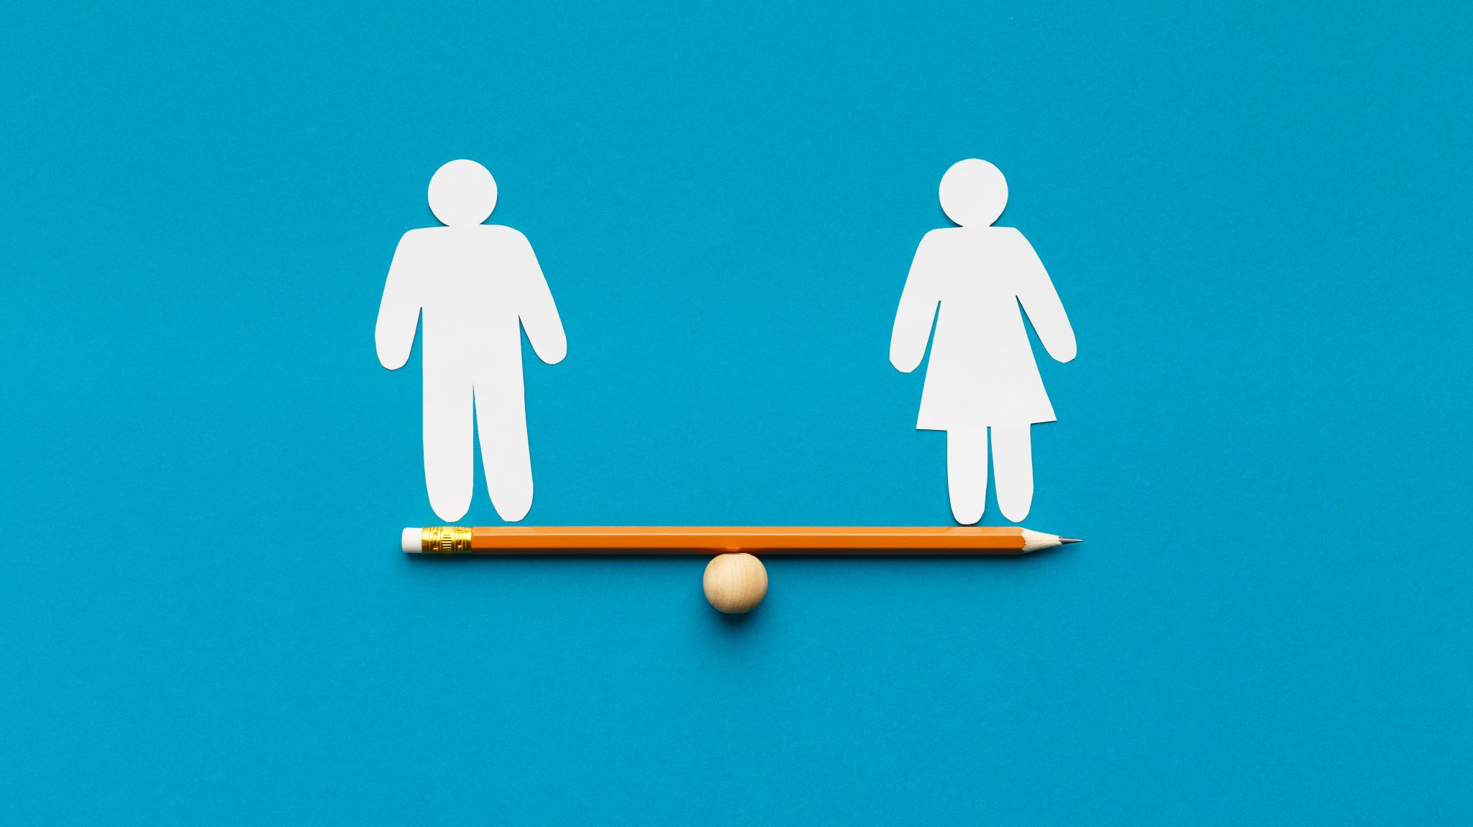
Introduction of Social Comparison

Slide 5
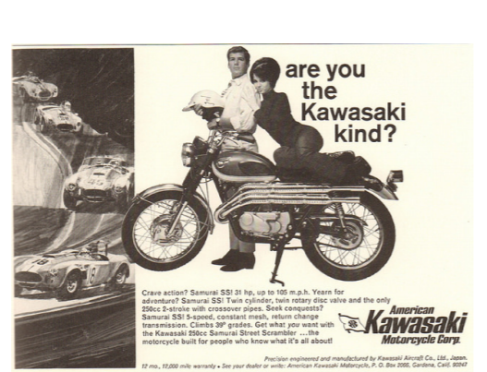
Social Comparison: Basics
Social comparison is a well-known concept to advertisers. They create idealized images that influence consumers’ self-perceptions as well as the things they feel they must buy in order to be satisfied.
[Image: SenseiAlan, http://goo.gl/XOwjq5, CC BY 2.0, http://goo.gl/ T4qgSp]

Slide 6
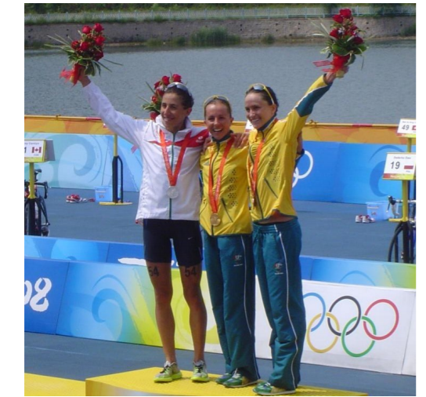
Social Comparison: Basics
When comparing, similarity is important.
A professional athlete is far more likely to compare his or her own performance against that of other professional athletes than that of an amateur.
[Image: Doma-w, https://goo.gl/2NM9Ii, CC BY 3.0, https://goo.gl/b58TcB]

Slide 7
Relevance and Similarity
Social Comparison:
Basics
The performance dimension has to be relevant to the self (Festinger, 1954).
For example, if excelling in academics is more important to you than excelling in sports, you are more likely to compare yourself with others in terms of academic rather than athletic performance

Slide 8
Direction of Social Comparison
“upward comparisons”
Social comparison is a bi-directional phenomenon where we can compare ourselves to people who are better than us or worse than us.
“downward comparisons.

Slide 9
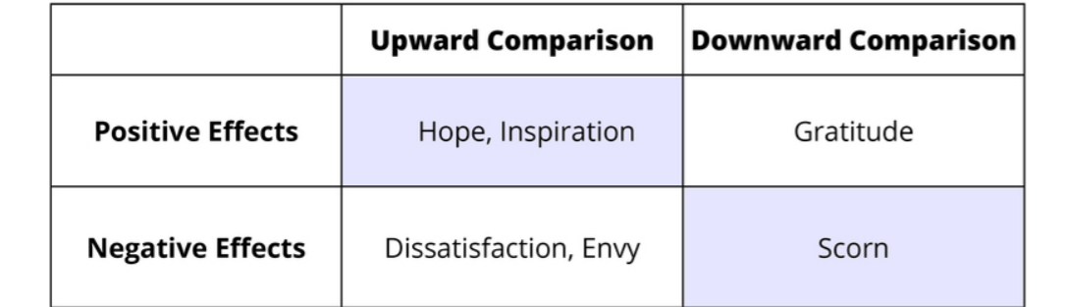
The effects of social comparison

Slide 10
Consequences of Social Comparison
Impact self-esteem:
For example, having the best final score in a class can increase your self-esteem quite a bit.
Lead to feelings of regret & envy:
As when someone with thinning hair envies the thick hair of a colleague.
Behave more competitively:
For example, you are among the top 10% on your class mid-term you might feel competitive with the other top students.

Slide 11
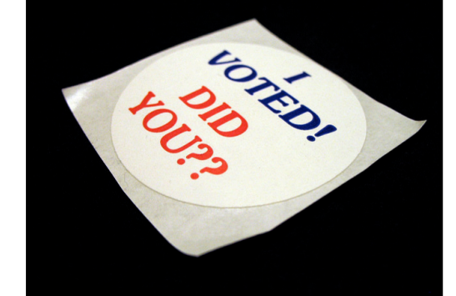
Consequences of Social Comparison
Comparing your behavior to that of other people might make you jealous, regretful or more motivated.
Lapel stickers and online badges that proclaim “I voted” or “I gave blood” are common examples of leveraging social comparison to achieve positive social outcomes.
[Image: CAVE CANEM, http://goo.gl/ifKSiE, CC BY 2.0, http://goo.gl/v4Y0Zv]

Slide 12
Self-Evaluation Maintenance Model
The self-evaluation maintenance (SEM; Tesser, 1988) model builds on social comparison theory.
SEM points to a range of psychological forces that help and maintain our self-evaluation and self-esteem.
SEM reveals the importance of relationship closeness affects self-evaluations.
Self-esteem: The feeling of confidence in one’s own abilities or worth.

Slide 13
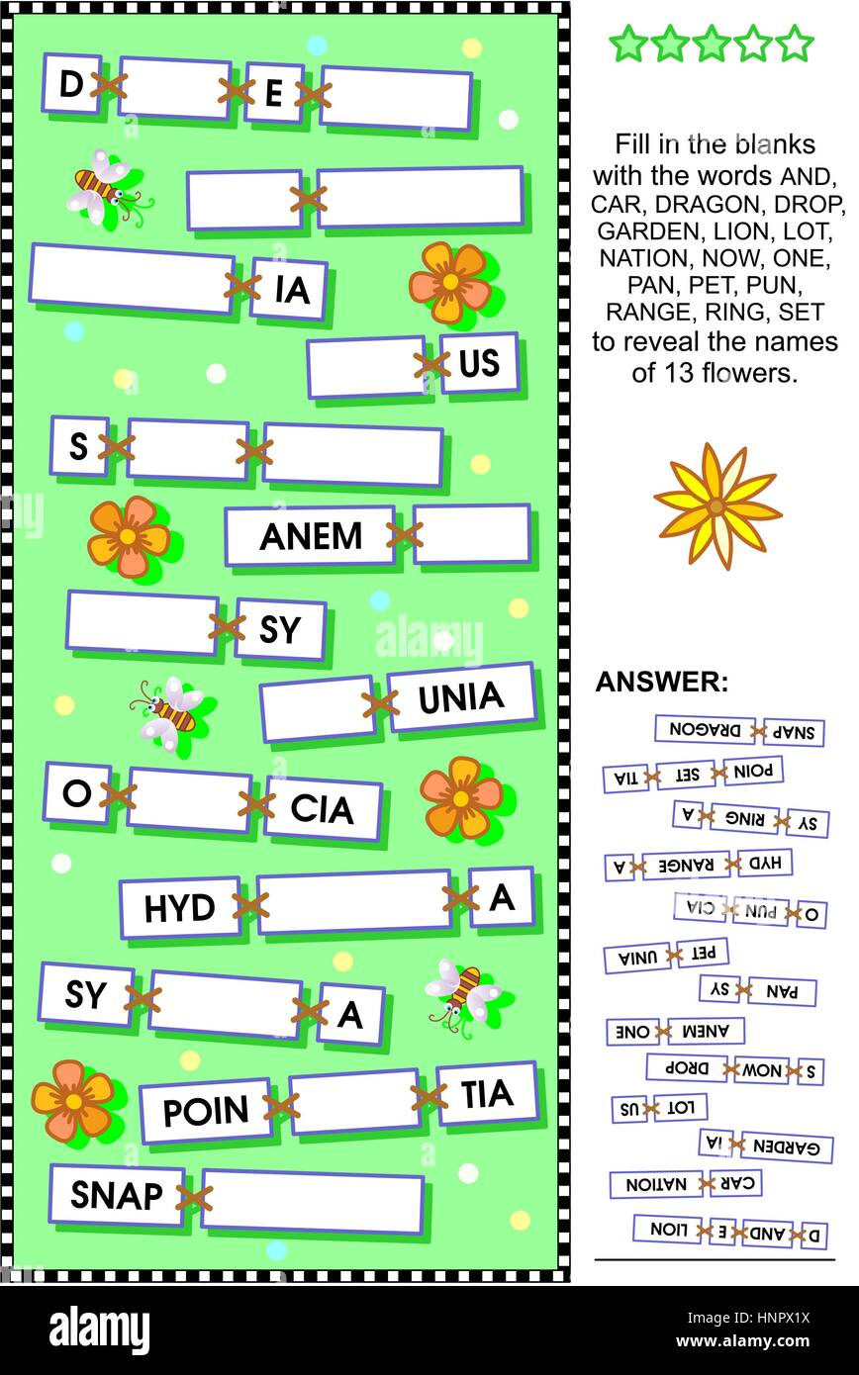

Experiment of Self-Evaluation Maintenance Model
In one study, Tesser and Smith (1980) asked people to play a verbal game in which they were given the opportunity to receive clues from a partner.
These clues could be used to help them guess the correct word in a word game. Half the participants were told the game was related to intelligence whereas the other half were not.
Additionally, half the participants were paired with a close friend, but the other half played with a stranger.

Slide 14
Experiment of Self-Evaluation Maintenance Model
Results show that participants who were led to believe the task was self-relevant or having to do with intelligence provided more difficult clues when their partner was a friend versus a stranger - suggesting a competitive uptick associated with relationship closeness.
However, when performance was implied to be irrelevant to the self, partners gave easier clues to friends than strangers.

Slide 15
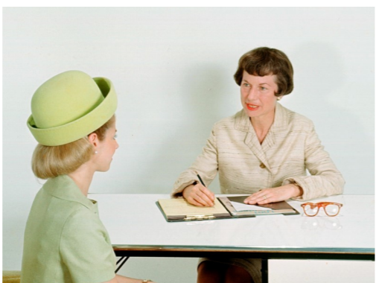
The SEM model suggests that managers may prefer sub-optimal candidates who aren’t likely to challenge their standing in the organization.
Notes:
Suboptimal (a): /sʌbˈɑːp.tə.məl/ not very good

Slide 16
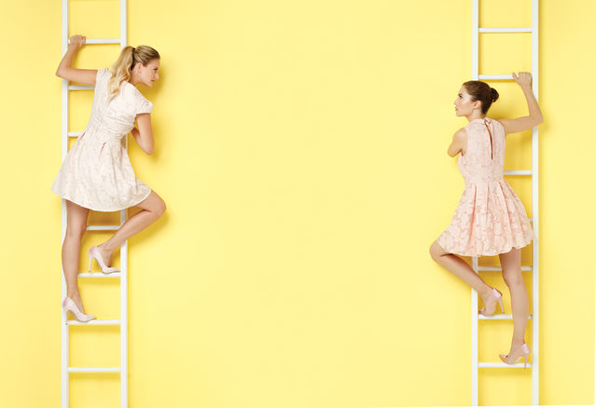
Individual Differences
The social comparison and its effects on self-evaluation will often depend on personality & individual differences.
For example, people with mastery goals may not interpret an upward comparison as a threat to the self but more as challenge, and a hopeful sign that one can achieve a certain level of performance.

Slide 17
Individual Differences
Another individual difference is whether one has a “fixed mindset” or “growth mindset” (Dweck, 2007).
People with fixed mindsets think that their abilities and talents cannot change; thus, an upward comparison will likely threaten their self-evaluation and prompt them to experience negative consequences of social comparison, such as competitive behavior, envy, or unhappiness. People with growth mindsets, however, are likely to interpret an upward comparison as a challenge, and an opportunity to improve themselves.

Slide 18
Situational factors
Number
Local
Proximity to a Standard
Social Category Lines
Notes:
Situational Factors (also known as External Factors) are influences that do not occur from within the individual but from elsewhere like the environment and others around you.

Slide 19
Situational factors
NUMBER
As the number of comparison targets (i.e., the number of people with whom you can compare) increases, social comparison tends to decrease.
For example, imagine you are running a race with competitors of similar ability as your own, and the top 20% will receive a prize. Do you think you would try harder if there were only 10 people in the race, or if there were 100? The findings on N-Effect (Garcia & Tor, 2009; Tor & Garcia, 2010) suggest the answer is 10.
As the number of competitors increases, social comparison—one of the engines behind competitive motivation—becomes less important. Perhaps you have experienced this if you have had to give class presentations. As the number of presenters increases, you feel a decreasing amount of comparison pressure.
Notes:
Situational Factors (also known as External Factors) are influences that do not occur from within the individual but from elsewhere like the environment and others around you.

Slide 20
Situational factors
LOCAL
People are more influenced by social comparison when the comparison is more localized rather than being broad and general.
For example, if you wanted to evaluate your height by using social comparison, you could compare your height to a good friend, a group of friends, people in your workplace, or even the average height of people living in your city. Although any of these comparisons is hypothetically possible people generally rely on more local comparisons. They are more likely to compare with friends or co-workers than they are to industry or national averages. So, if you are among the tallest in your group of friends, it may very well give you a bigger boost to your self-esteem, even if you’re still among the shortest individuals at the national level.

Slide 21
Situational factors
LOCAL
It is natural to make comparisons between oneself and others on a variety of different standards and to compare oneself with a variety of different people. Comparisons to friends are among the most influential of all.
[Image: Corrie M, http://goo.gl/FRbOfQ, CC BY-ND 2.0, http://goo.gl/FuDJ6c]

Slide 22
Situational factors
PROXIMITY TO A STANDARD
Social comparison involves the proximity of a standard - such as the #1 ranking or other qualitative threshold. One consequence of this is an increase in competitive behavior.
For example, in childhood games, if someone shouts, “First one to the tree is the coolest-person-in the-world!” then the children who are nearest the tree will tug and pull at each other for the lead. However, if someone shouts, “Last one there is a rotten-egg!” then the children who are in last place will be the ones tugging and pulling each other to get ahead. In the proximity of a standard, social comparison concerns increase. We also see this in rankings. Rivals ranked #2 and #3, for instance, are less willing to maximize joint gains (in which they both benefit) if it means their opponent will benefit more, compared to rivals ranked #202 and #203 (Garcia, Tor, & Gonzalez, 2006; Garcia & Tor, 2007). These latter rivals are so far from the #1 rank (i.e., the standard) that it does not bother them if their opponent benefits more than them. Thus, social comparison concerns are only important in the proximity of a standard.
Notes:
Proximity /prɑːkˈsɪm.ə.t̬i/ the state of being near in space or time
Rival /ˈraɪ.vəl/ a person, group, etc. competing with others for the same thing or in the same area

Slide 23
Situational factors
SOCIAL CATEGORY LINES
Social comparison can also happen between groups. This is especially the case when groups come from different social categories versus the same social category.
For example, if students were deciding what kind of music to play at the high school prom, one option would be to simply flip a coin—say, heads for hip-hop, tails for pop. In this case, everyone represents the same social category—high school seniors—and social comparison isn’t an issue. However, if all the boys wanted hip-hop and all the girls wanted pop, flipping a coin is not such an easy solution as it privileges one social category over another (Garcia & Miller, 2007).
Notes:
Privilege /ˈprɪv.əl.ɪdʒ/ an advantage that only one person or group of people has, usually because of their position or because they are rich

Slide 24
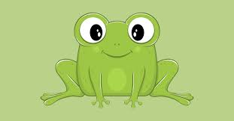
Related Phenomena
FROG POND EFFECT
As a frog, would you rather be in a small pond where you’re a big frog, or a large pond where you’re a small frog?
People in general had a better academic self-concept if they were a big frog in a small pond (e.g., the top student in their local high school) rather than a small frog in a large one (e.g., one of many good students at an Ivy League university).
According to Marsh, Trautwein, Ludtke and Koller (2008)

Slide 25
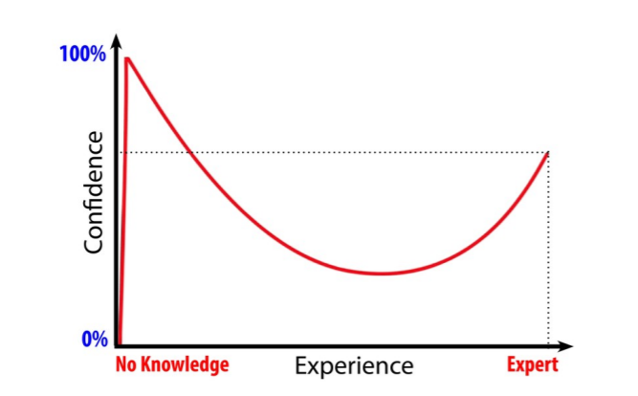
Related Phenomena
THE DUNNING-KRUGER EFFECT
The Dunning-Kruger Effect shows that the least experienced and least knowledgeable people are over-confident. These people don’t know what they don’t know and are more likely to overestimate their own abilities.

Slide 26
Think about it: how could you ever gauge your skills in chess without having anyone to compare yourself to?
Social comparison
Social comparison is a natural psychological tendency and one that can exert a powerful influence on the way we feel and behave.
Social comparison is not an ugly phenomenon to be avoided.
Social comparison has many positive aspects.
The engine of social comparison can also provide the push you need to rise to the occasion and increase your motivation, and therefore make progress toward your goals.
Conclusions

Slide 27
Discussion Questions
On what do you compare yourself with others? Qualities such as attractiveness and intelligence? Skills such as school performance or athleticism? Do others also make these same types of comparisons or does each person make a unique set? Why do you think this is?
How can making comparisons to others help you?
One way to make comparisons is to compare yourself with your own past performance. Discuss a time you did this. Could this example be described as an “upward” or “downward” comparison? How did this type of comparison affect you?

Slide 28

Q&A

